Slide 1



CUSTOMER RETENSION STRATEGY
GERMANY FRANCE SPAIN
Presented by: Andreas Dellamanis, Anna Syrigonaki, George Dimou, Panagiotis Defto

Slide 2

GOALS AND OBJECTIVES
Goals
Increasing loyalty of our customers in 3 European Countries
Objectives
Increase customer retension and product’s usage over the year

Slide 3

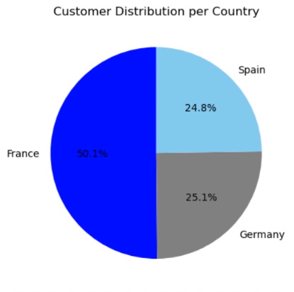
Customer’s Distribution per Country
The majority of the customers are in the French Market with the average tenure 5 years

Slide 4
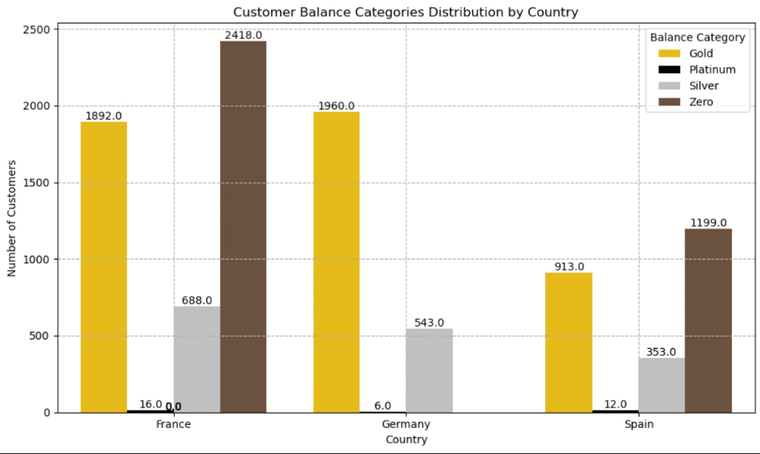
Customer
Segmentation
France might have the biggest amount of customers, however the 0EUR accounts are around 49% of them
Germany has no customers with 0EUR and the customers with the higher amount of bank deposits

Slide 5




LOYALTY OF CUSTOMERS IN FRANCE
50%
Users of product 1
24%
New users that use product 1+ 2

Slide 6
LOYALTY OF CUSTOMERS IN GERMANY
53%
Users of product 1
25%
New users that use product 1+ 2

Slide 7
LOYALTY OF CUSTOMERS IN SPAIN
49%
product 1 users vs 48% product 2
23%
New users that use product 1+ 2

Slide 8




STRATEGY FOR THE NEXT Q
Germany
Engage more the new customers with the other products and increase the users from product 1 and 2
France
Engage more the new customers with the other products
Spain
Promote product 3 to the customers already using product 2

Slide 9

Thank's For Watching
Connect with us.
da@abcbank.com

